Slide 1
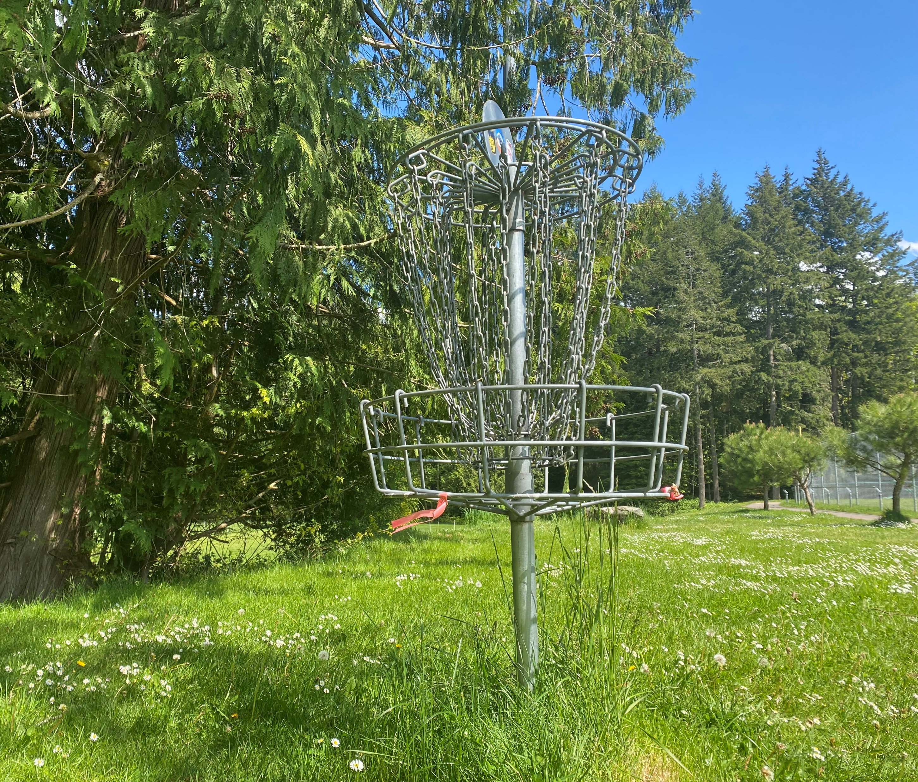
Disc Golf Course Survey Analysis
‘23

Slide 2
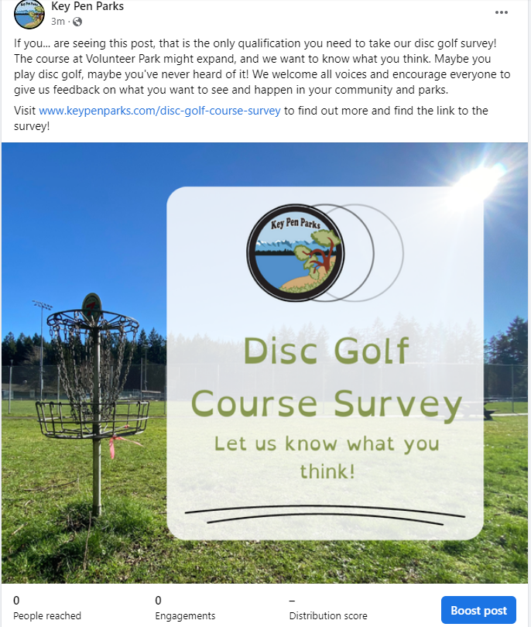
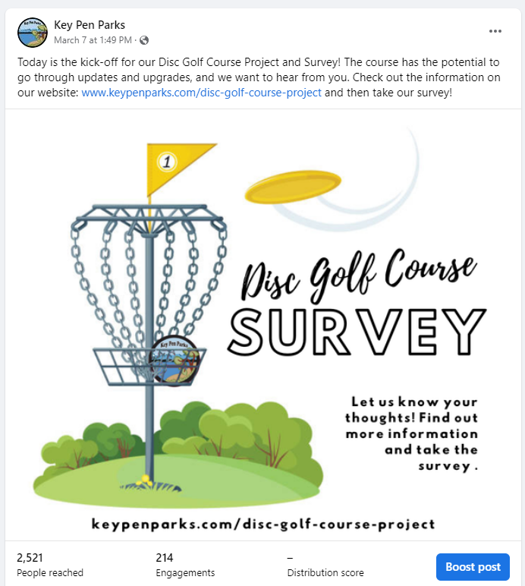
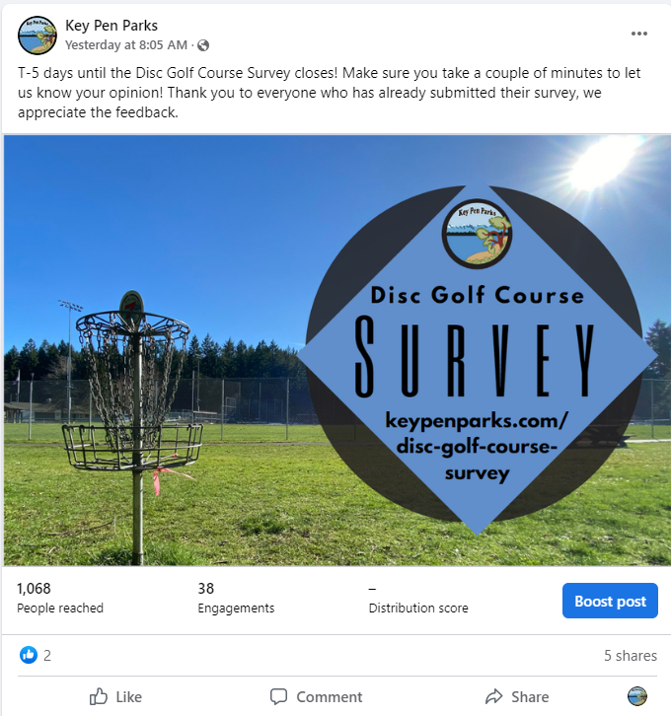
Records of Process – Social Media
Weekly Facebook posts and final week story posts
4 photo posts (average of 1870 people reach for each post)
1 video post (288 people reached)
1 story post
Posts were also “shared” to local Key Peninsula Facebook pages

Slide 3
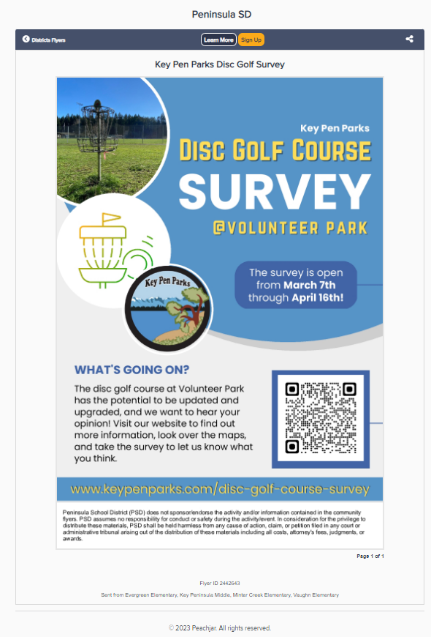
Records of Process – Engaging the schools
Peach Jar flyers (online) distributed to Evergreen Elementary, Vaughn Elementary, Minter Creek Elementary, and Key Peninsula Middle School.
The KPMS PTA was contacted to request a presentation of the disc golf webpage and the survey – no response received.

Slide 4
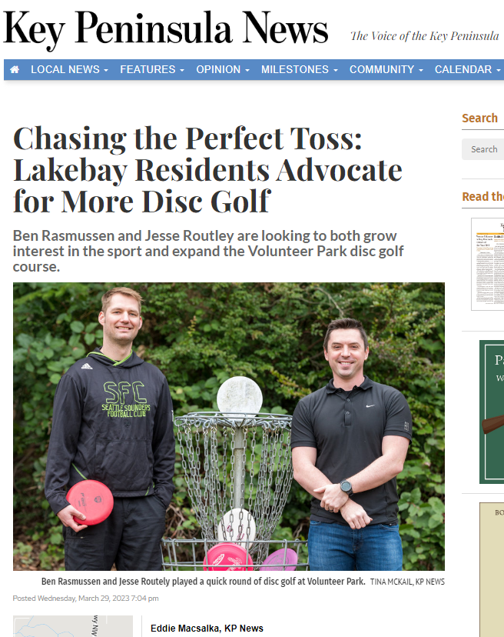
Records of Process – In the news
Ad included in the Key Pen Parks section of the Key Peninsula News
The survey was mentioned in an article titled “Chasing the Perfect Toss: Lakebay Residents Advocate for More Disc Golf” in the March edition of the KP News
Links to the Disc Golf Course Project webpage on the Key Pen Parks website were included in the March and April newsletter

Slide 5
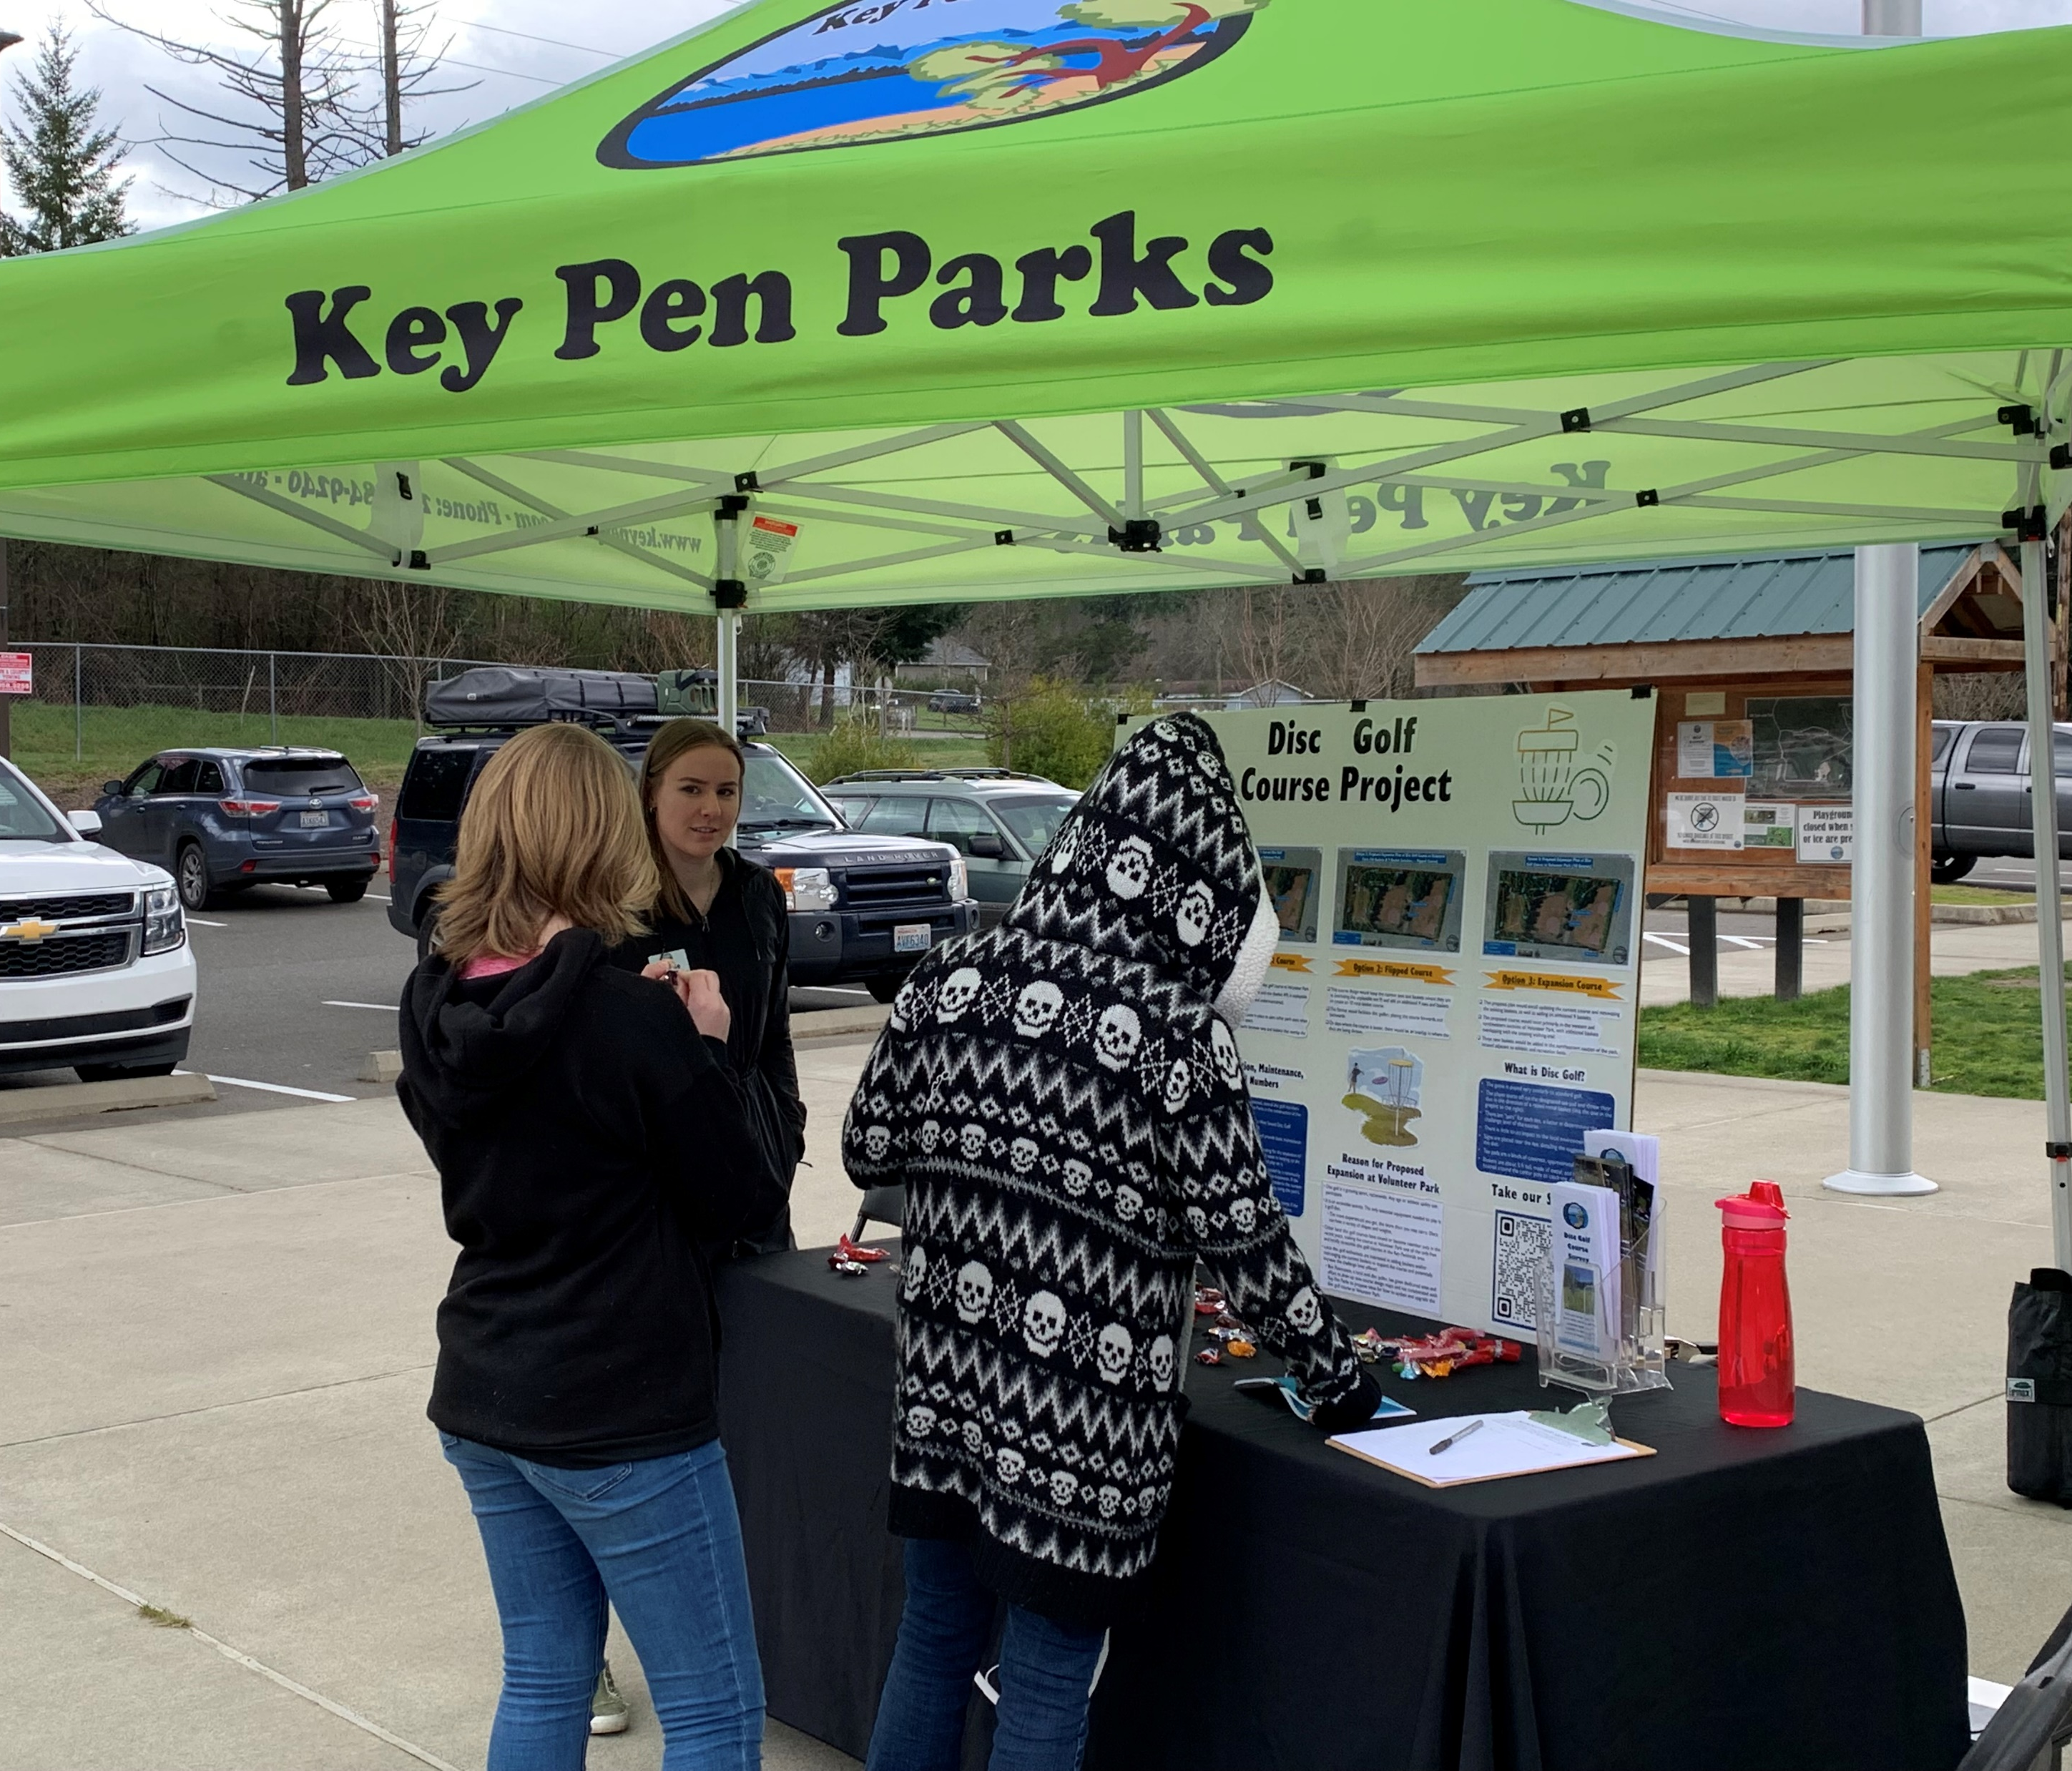
Records of Process – Community Engagement
2 pop-ups in the parks (at Volunteer Park and at Gateway Park)
Reached out to the Key Peninsula Community Council, the Key Peninsula Civic Center, and the Gig Harbor Rotary – no responses received
Visited Red Barn Youth Center and gave a brief introduction to the disc golf course project to almost 30 middle-school aged children
Notes:
Reached out to the Key Peninsula Community Council, the Key Peninsula Civic Center, and the Gig Harbor Rotary in hopes of making special presentations about the potential updates and upgrades to the project or utilizing these organizations as an outlet to distribute the survey

Slide 6
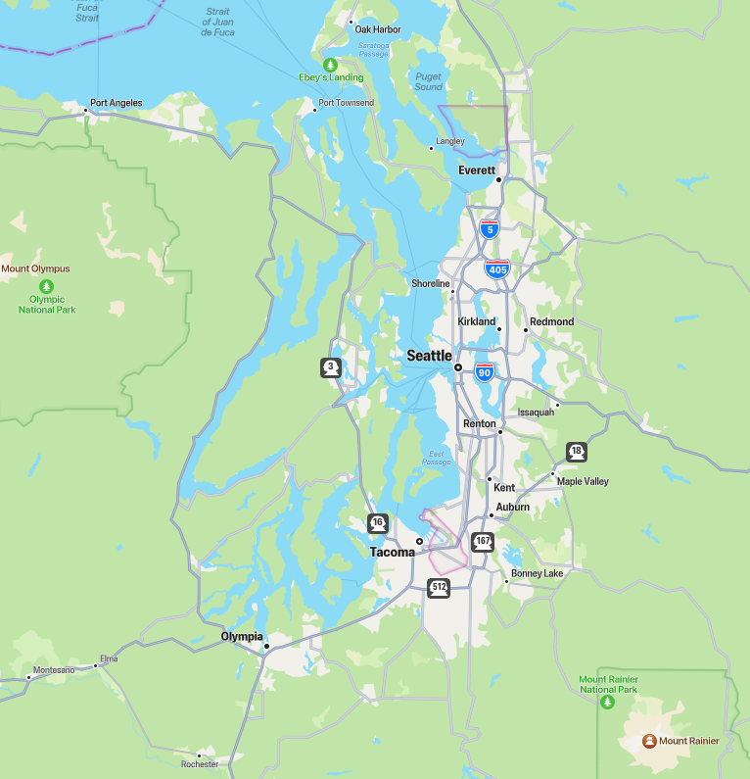
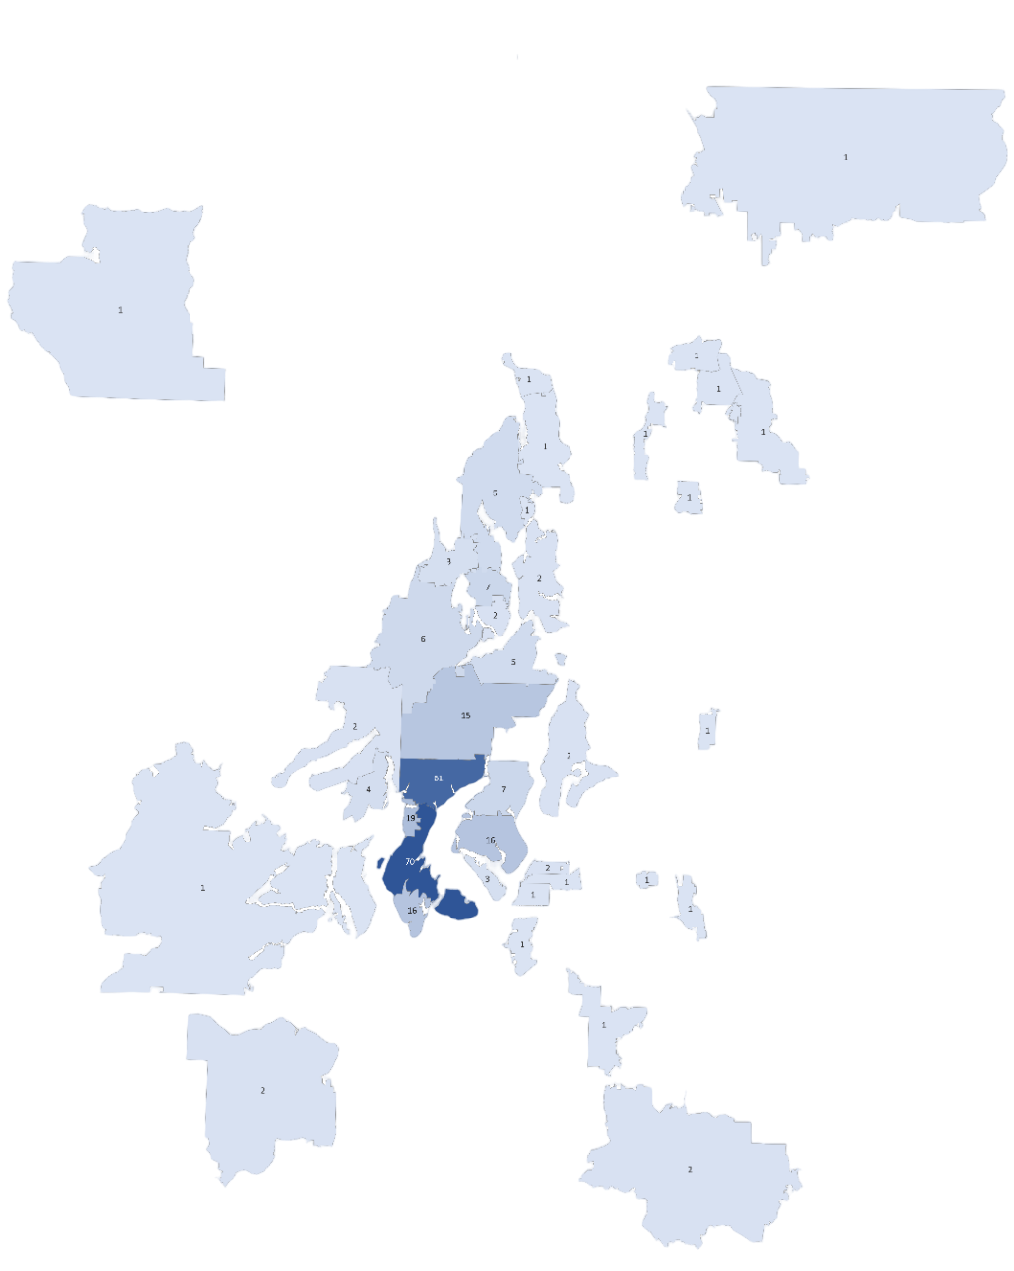
City | Zip Code | Responses | Option 1 | Option 2 | Option 3
Lakebay | 98349 | 70 | 12 | 14 | 44
Wauna | 98329 | 61 | 6 | 5 | 50
Vaughn | 98394 | 19 | 2 | 3 | 14
Gig Harbor | 98335 | 16 | 0 | 1 | 15
Longbranch | 98351 | 16 | 1 | 1 | 14
Port Orchard | 98367 | 15 | 0 | 0 | 15
Bremerton | 98311 | 7 | 0 | 0 | 7
Gig Harbor | 98332 | 7 | 0 | 1 | 6
Bremerton | 98312 | 6 | 0 | 0 | 6
Poulsbo | 98370 | 5 | 0 | 0 | 5
Port Orchard | 98366 | 5 | 0 | 0 | 5
Allyn | 98524 | 4 | 0 | 0 | 4
Fox Island | 98333 | 3 | 0 | 0 | 3
Silverdale | 98383 | 3 | 0 | 0 | 3
Tacoma | 98406 | 2 | 0 | 0 | 2
Bremerton | 98310 | 2 | 0 | 0 | 2
Wauna | 98395 | 2 | 0 | 0 | 2
Olympia | 98512 | 2 | 0 | 0 | 2
Bremerton | 98337 | 2 | 0 | 0 | 2
Eatonville | 98328 | 2 | 0 | 0 | 2
Belfair | 98528 | 2 | 0 | 0 | 2
Bainbridge Island | 98110 | 2 | 0 | 0 | 2
Vashon | 98070 | 2 | 0 | 0 | 2
Bremerton | 98310 | 2 | 0 | 0 | 2
Hansville | 98340 | 1 | 0 | 0 | 1
Shelton | 98584 | 1 | 0 | 0 | 1
Everett | 98208 | 1 | 0 | 0 | 1
Arlington | 98223 | 1 | 0 | 0 | 1
Shelton | 98584 | 1 | 0 | 0 | 1
Spanaway | 98387 | 1 | 0 | 0 | 1
Tacoma | 98465 | 1 | 0 | 0 | 1
Renton | 98055 | 1 | 0 | 0 | 1
Tacoma | 98405 | 1 | 0 | 0 | 1
Snohomish | 98296 | 1 | 0 | 0 | 1
Fircrest | 98466 | 1 | 0 | 0 | 1
Kingston | 98346 | 1 | 0 | 0 | 1
Bethel | 98387 | 1 | 0 | 0 | 1
Lakewood | 98498 | 1 | 0 | 0 | 1
Suquamish | 98392 | 1 | 0 | 0 | 1
Kenmore | 98028 | 1 | 0 | 0 | 1
Sumner | 98352 | 1 | 0 | 0 | 1
Edmonds | 98026 | 1 | 0 | 1 | 0
Everett | 98203 | 1 | 0 | 0 | 1
Port Angeles | 98362 | 1 | 0 | 0 | 1
Milton | 98354 | 1 | 0 | 0 | 1
Fort Collins | 80524 | 1 | 0 | 0 | 1
Total |  | 279 | 21 | 26 | 232

Slide 7
Responses by numbers…
Total number of survey responses: 279
An additional 33 people began the survey but did not complete it.
Only fully completed surveys were considered for analysis.
46 total zip codes were represented.
97.8% of zip codes represented are from the greater Puget Sound region.
The other 2.2 % of zip codes represented were in Colorado.
57.7% of responses were collected from Key Peninsula zip codes (98349, 98329, 98394, & 98351).
24% from 98349, 21% from 98329, 6.8% from 98394, 5.4% from 98351.

Slide 8
Demographics and introduction questions
Notes:
Only 15% of survey responders were under 18 years hold
Single selection
40% visit VP several times a year
19% visit once a month
15% visit several times a week
14% visit once a week
10% never use the park

Slide 9
Demographics and introduction questions
Notes:
Multiple selections allowed
73% say other adults visit with them
39% say they visit with children under the age of 16
23% say they come with their dog
13% say they come alone
Multiple selections allowed
70% say they visit Volunteer Park for the disc golf course
40% say they visit VP for the Snack Shack
23% visit for to walk the trails
17% visit for the playground

Slide 10
Demographics and introduction questions
Notes:
Multiple selections allowed
70% say they visit Volunteer Park for the disc golf course
40% say they visit VP for the Snack Shack
23% visit for to walk the trails
17% visit for the playground

Slide 11
Demographics and introduction questions

Slide 12
Demographics and introduction questions

Slide 13
For those who do not play disc golf at Volunteer Park…

Slide 14
For those who do play disc golf at Volunteer Park…

Slide 15
For those who do play disc golf at Volunteer Park…

Slide 16
For those who are uncomfortable in the park because of the disc golf course…

Slide 17
General reactions across all zip codes…

Slide 18
General reactions from the Key Peninsula…

Slide 19
What’s the verdict…

Slide 20
What’s the verdict (voices from the KP)…

Slide 21
Themes from the free response section
Out of the 279 total survey responses, 155 people submitted an optional comment at the end of the survey. 90 of those were from the Key Peninsula.
In summary, the main theme was that people are supportive and excited about any potential updates and upgrades.
People also submitted suggestions in this section.
Redesign certain aspects of Option 3 to limit the overlap between the course and the walking trails.
Include plenty of signage (education, etiquette, and safety) around the course.
Provide adequate trash bins to help keep the space litter free.
Make sure there is actually space at Volunteer Park for 18 baskets.
A few of requests to move the course to Gateway Park.
There were only a handful of negative comments.
Not worth the money.
Worries about safety and overcrowding Volunteer Park.
Protect the athletic fields and general open space use of the park.

Slide 22
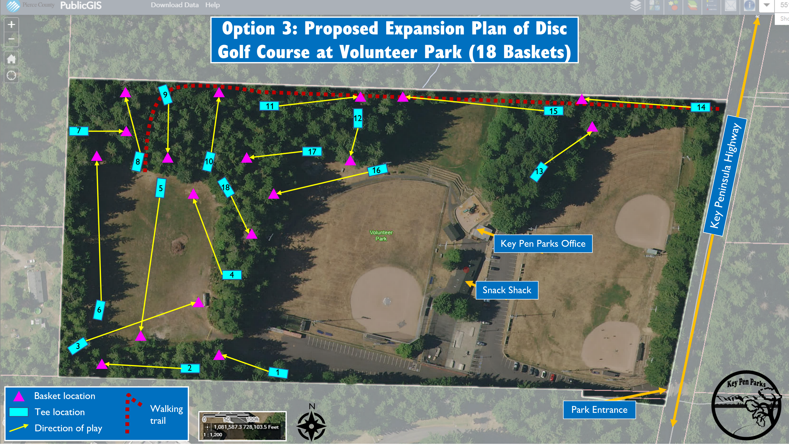
Staff recommendation
After reviewing the survey answers, we recommend following through with Option 3, the expansion course including 18 baskets, with consideration of the following to mitigate community concerns…
The course design can be adjusted to limit the overlap between disc paths and walking trails.
An abundance of signage (for education, course etiquette, and safety) can be provided.

Slide 23
Proposed timeline…
After the expansion course design is finalized with the suggested considerations in mind and the SEPA review process is completed, the implementation process will most likely begin close to the end of the 2023 calendar year.

Slide 24
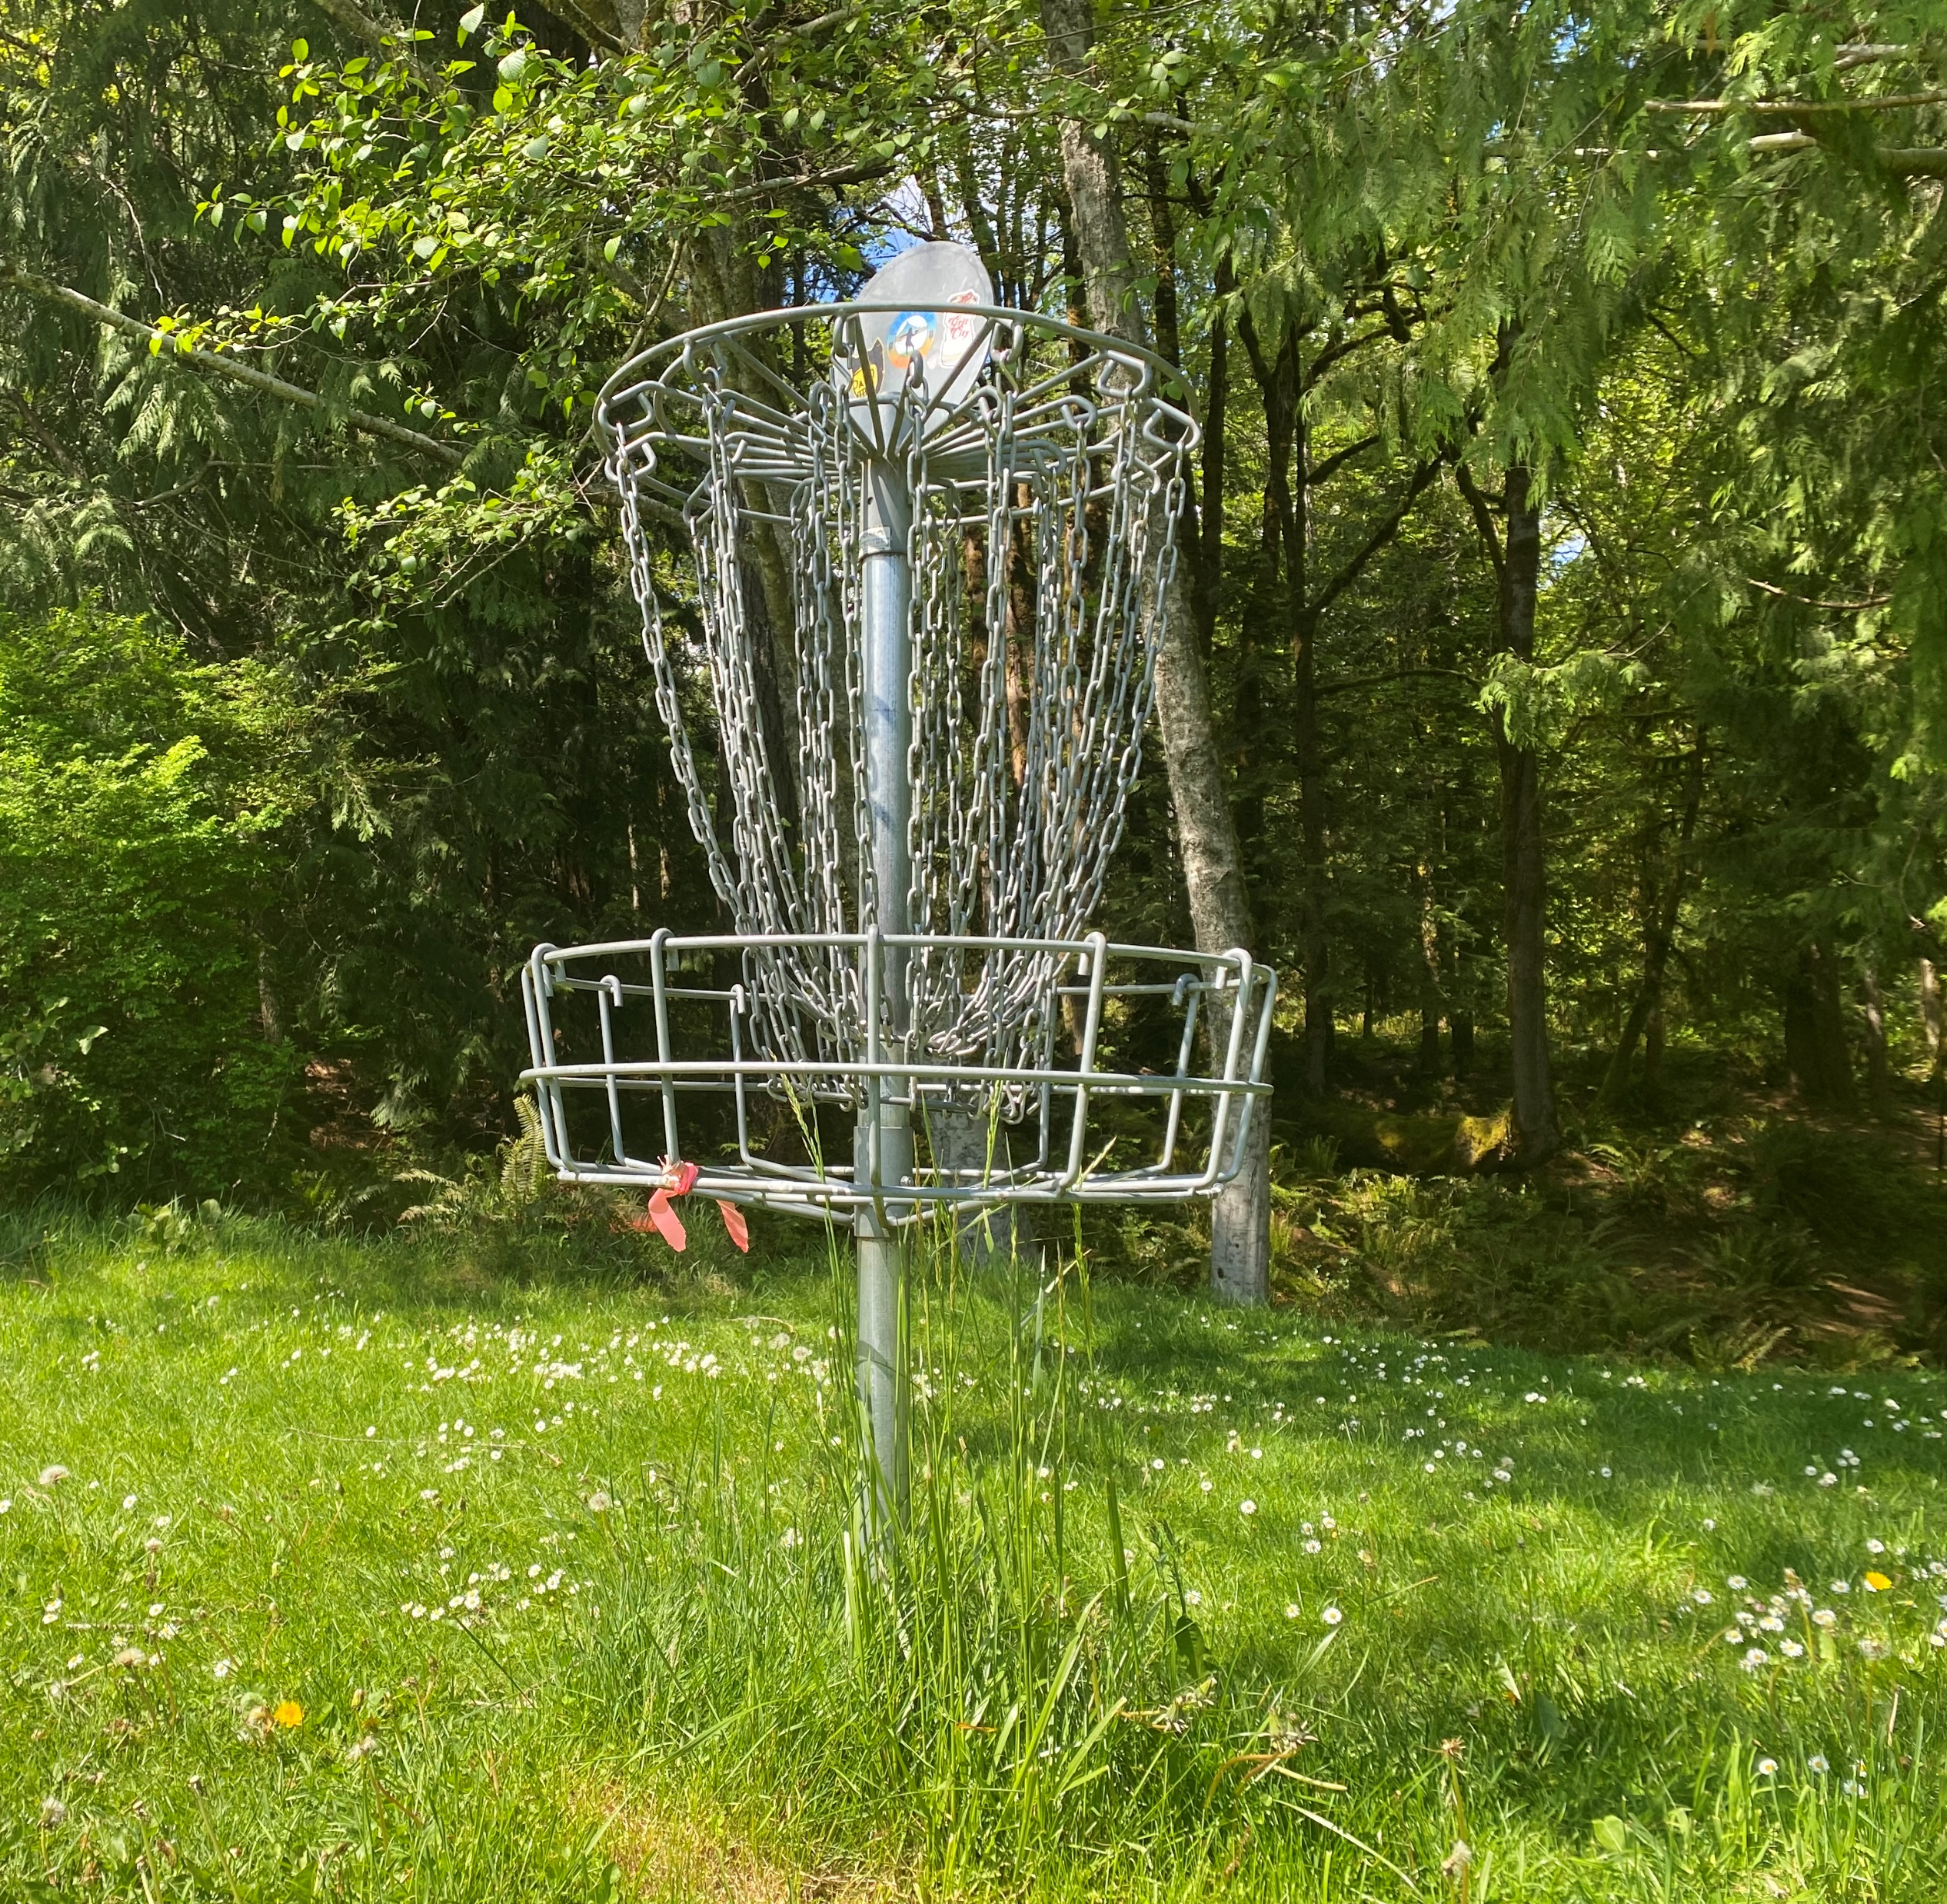
Questions or comments?

